Slide 1
Exploratory Data Analysis

Slide 2
creative
philosophy
complement
ambiguous
tools
in practice
OVERVIEW

Slide 3
EDA as a creative process
There are multiple techniques, but NOT a fixed set that you have to use.
Let the data speak for themselves
wait until a plausible “story” emerges
data reveal its underlying structure and model
Do not “torture” the data set
if a variable/feature is surprising then continue exploring
data interpretation requires background knowledge
EDA competence and confidence come with practice
Notes:
EDA is prior to any formal statistical modeling and inference
EDA is similar to a crime scene investigation:
- collects clues related to the central question of the case
- does not collect just any information

Slide 4
EDA as a philosophy
maintain an open mind
consider multiple perspectives
willingness to examine the outliers
reexpressing data to explore unanticipated patterns
treat scales of measurements as arbitrary
emphasis upon visual displays - be skeptical of measures that summarise data
Notes:
Summary Statistics:
conceal interesting facts
have unreasonable hidden assumptions about the nature of the data
Even though they may be easy to forget - don’t ignore the outliers!

Slide 5
EDA complements CDA
EDA complements traditional confirmatory data analysis (CDA) by:
helping to generate a "working" hypothesis
spotting outliers and assumption violations that might invalidate CDA
Notes:
EDA begins with the data (not any summaries/theories of the data)

Slide 6
EDA is ambiguous
CDA is biased:
predetermined hypothesis can lead to overlooking counterexamples
provides a false sense of certainty, which is often preferred by the audience
EDA is ambiguous:
allows the analysis to be open and explore all the data
“Far better an approximate answer to the right question, which is often vague,
than an exact answer to the wrong question, which can always be made precise.”
John Tukey
Notes:
premise: it is better to be “approximately right” rather than “exactly wrong”

Slide 7
tools within EDA

Slide 8
EDA has some tools
columns of numbers are difficult to interpret (large datasets are tedious, boring, and/or overwhelming)
Graphical techniques:
Plotting the raw data
stem-and-leaf diagrams
histograms
scatter plots
Plotting simple statistics
mean plots
box plots
residual plots
Positioning (multiple) plots to amplify cognition
Univariate methods
look at one variable (data column) at a time
What type of variation occurs within my variables?
Quantitative techniques:
Summary statistics, data profiling
Interval estimation
Measures of location or of scale
Shapes of distributions
Residual analysis
Data re-expression
Multivariate methods
look at two or more variables at a time to explore relationships
What type of covariation occurs between my variables?

Slide 9
EDA in practice

Slide 10
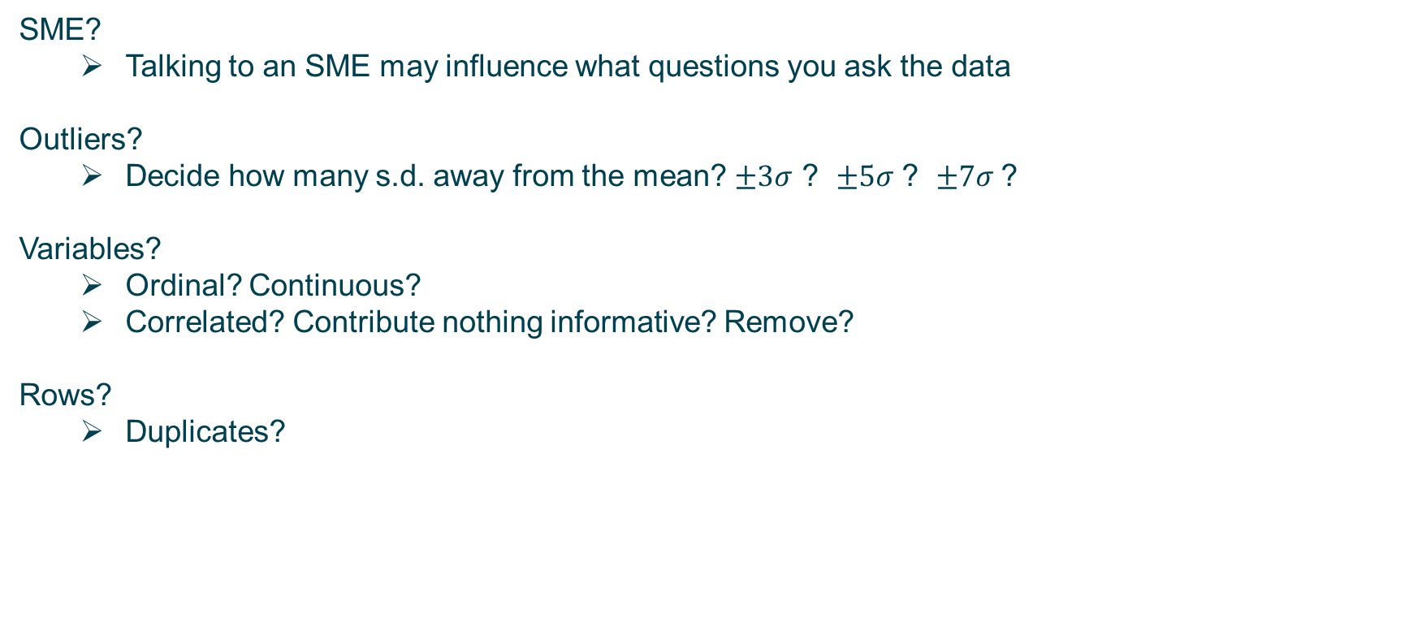
EDA in practice
SME?
Talking to an SME may influence what questions you ask the data
Outliers?
Decide how many s.d. away from the mean? $±3σ$ ? $±5σ$ ? $±7σ$?
Variables?
Ordinal? Continuous?
Correlated? Contribute nothing informative? Remove?
Rows?
Duplicates?

Slide 11
EDA in practice: example
Together we will review a simple EDA of iris:
contains 3 classes of 50 instances each,
each class refers to a type of iris plant
See: DG_03b-EDA-Examples-iris.ipynb
.describe
.boxplot [sns]
.hist
.kdeplot [sns]
.heatmap [sns]
.scatter
.pairplot [sns]
.violinplot [sns]
Exercise: Conduct an exploratory data analysis on any of the three data sets:
Iris
NYC Taxi
Binary Classification
Notes:
NB: the first 15 lines of DG_03b-EDA-Examples-iris.ipynb bring in the data; python is a tool to help with EDA, so focus more on the exploration, for intuition.

